Slide 1

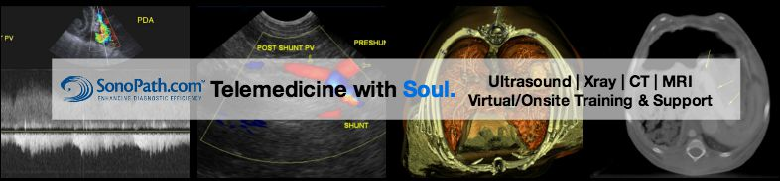
Hypoalbuminaemia as a possible biomarker of gastro-intestinal lymphoma in cats
R. Lobetti^{1,2}, E. Lindquist², C.Berman¹
¹Bryanston Veterinary Hospital, Bryanston, South Africa
² SonoPath, New Jersey, USA

Slide 2

Abstract disclosures
Authors have no disclosures related to this presentation

Slide 3
Introduction:
Gastrointestinal lymphoma:
Feline idiopathic Inflammatory bowel disease:
A chronic enteropathy immunologically mediated
Feline IBD affects middle-aged animals but also in cats <2 years of age
Limited published specifically with albumin levels in cats
In previous studies prevalence of hypoalbuminaemia ranged from 5% to 24%
Chronic intestinal inflammation a risk factor for the development of GIL?
Most common anatomical form in cats
Accounts for 32-72% of cases
Median age 13 years, range 1-20 years
Mild hypoalbuminaemia in 50% of cats
Hypoalbuminaemia in 49% of cats with lymphocytic and 50% with lymphoblastic
Albumin is one possible analyte that can help discriminate between IBD and GIT lymphoma

Slide 4
Diagnosis:
Ultrasound findings with GIL indistinguishable from IBD
Cats with GIL18 times more then with IBD- thickened muscularis layer
Diagnostic value of cytologic evaluation questionable
Histopathology necessary to confirm the diagnosis
Endoscopy or surgically obtained intestinal biopsies

Slide 5
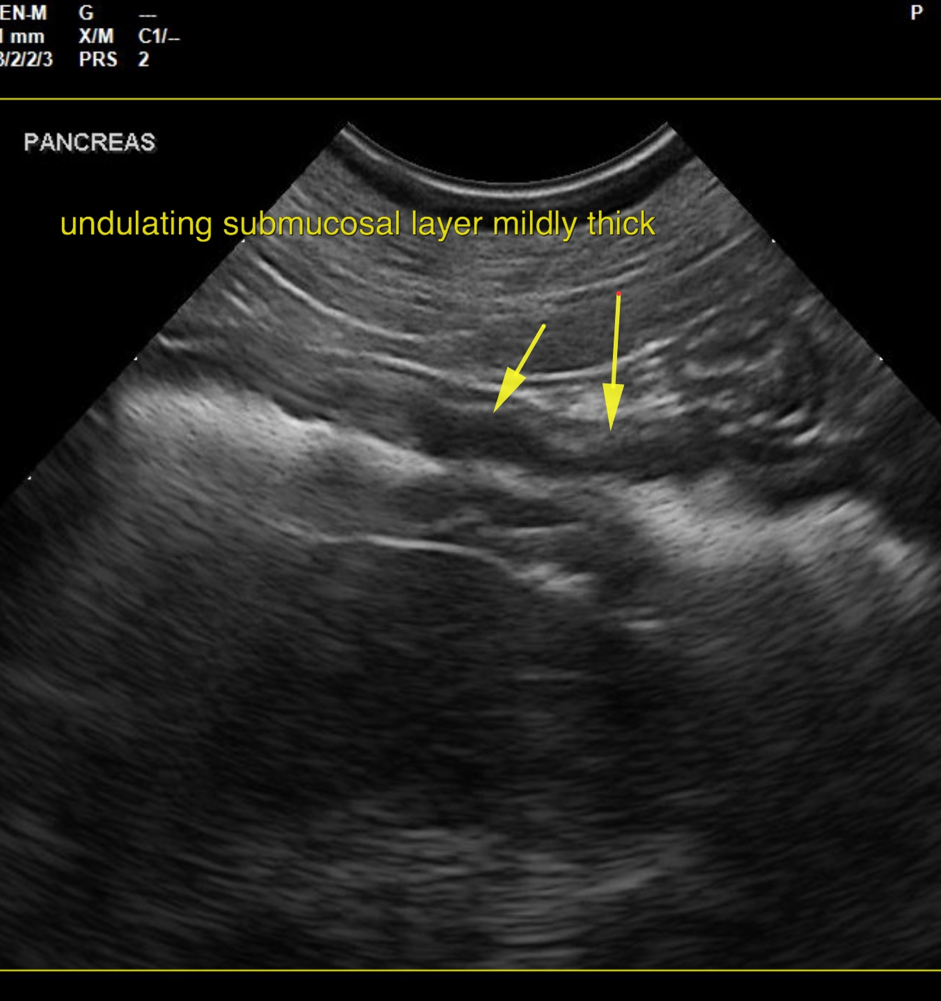
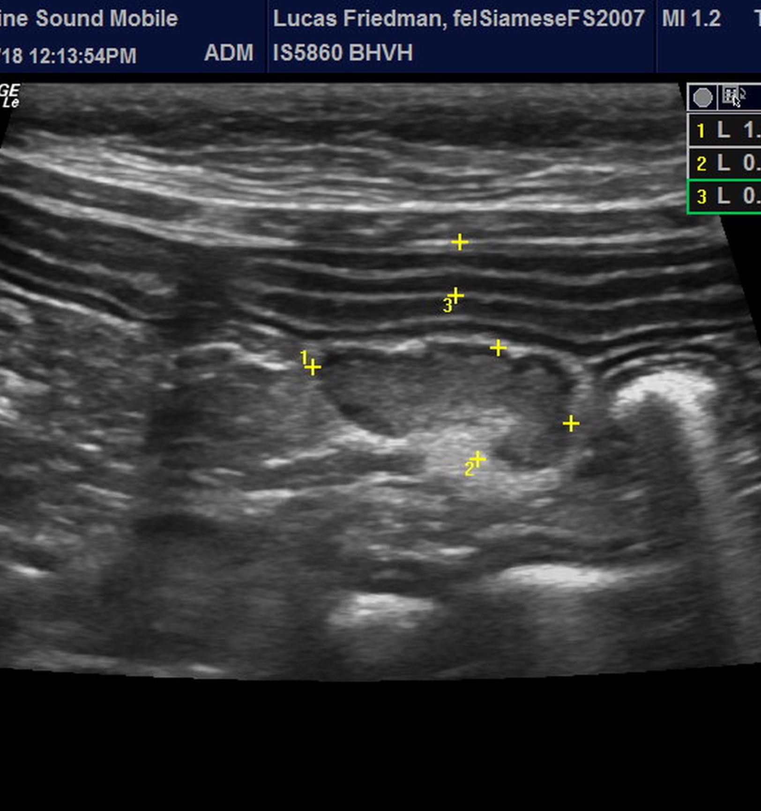
IBD

Slide 6
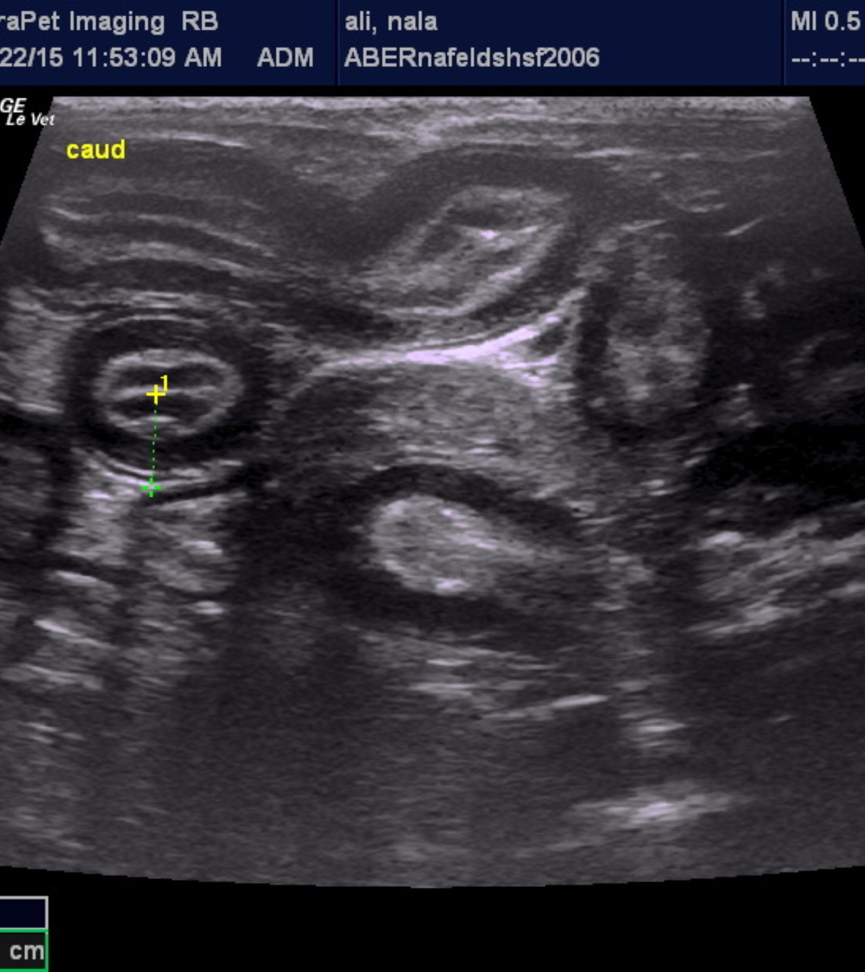
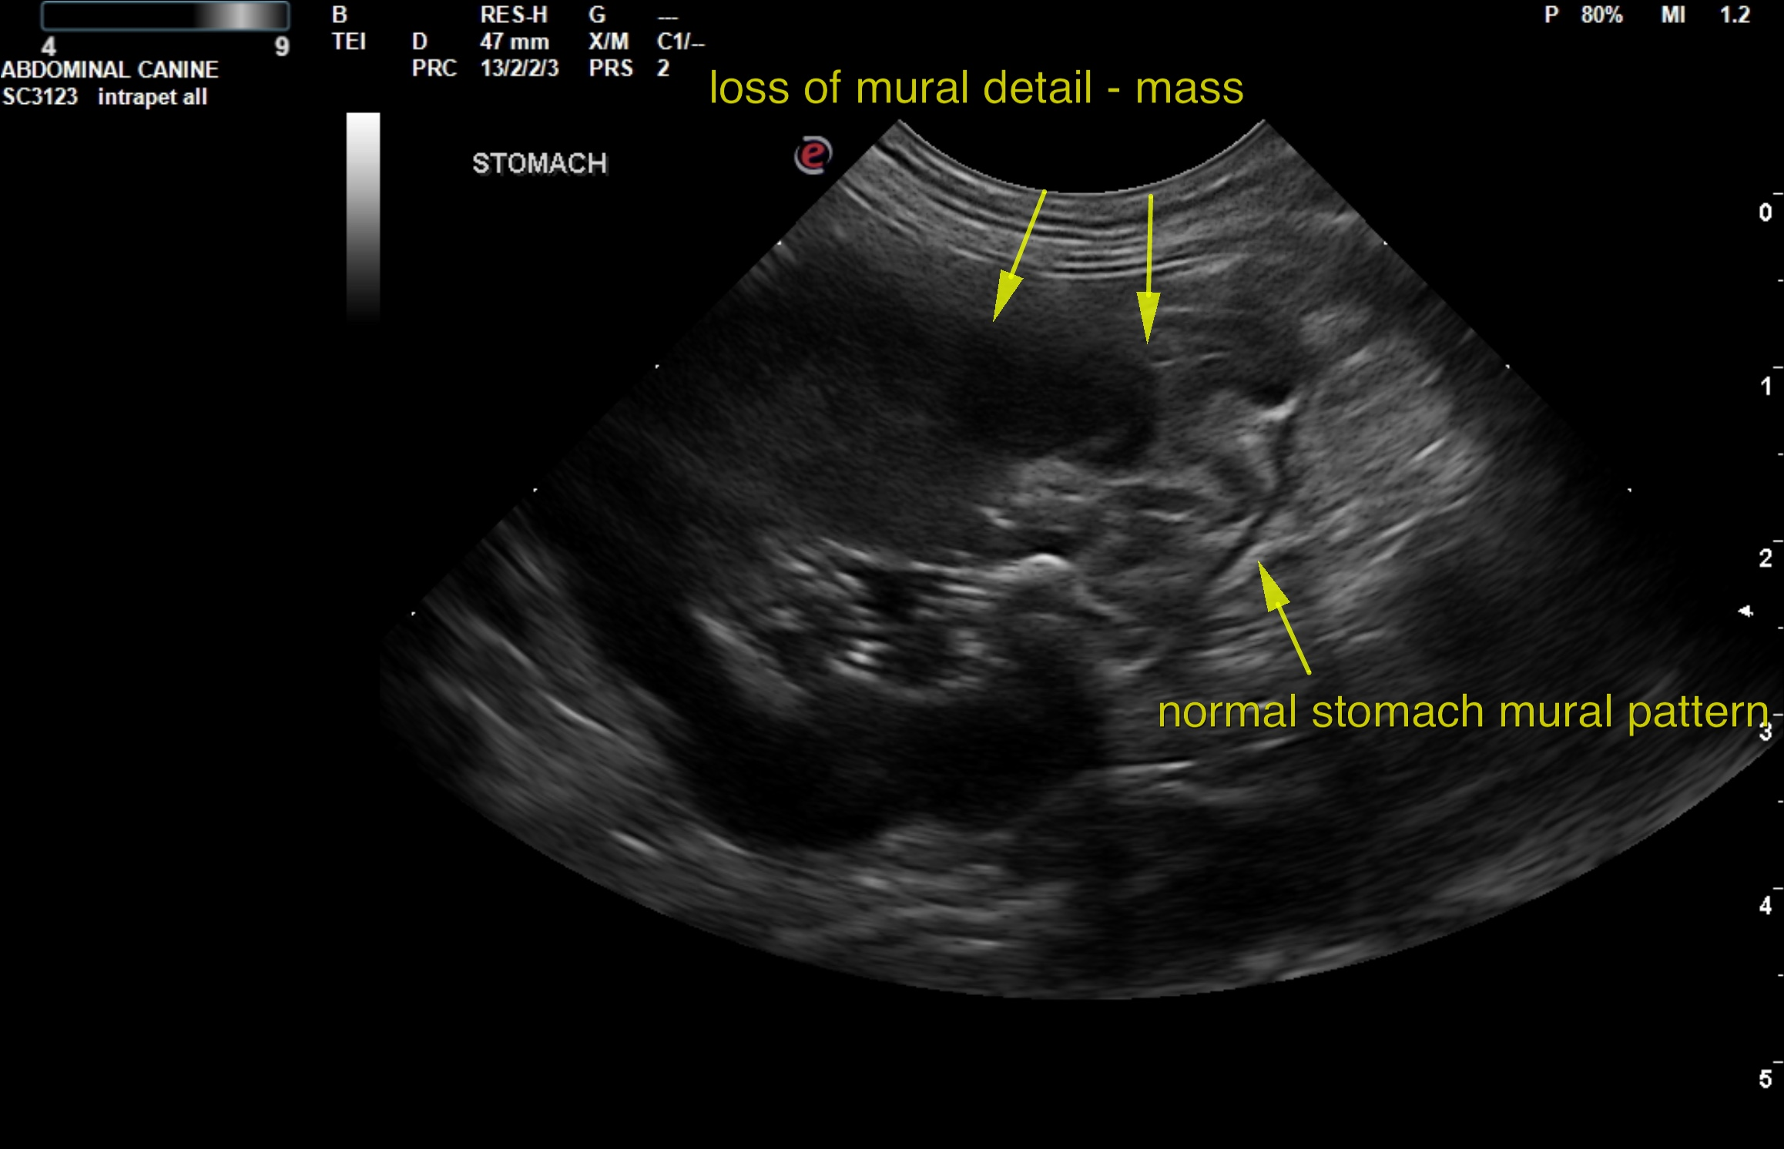
GIL

Slide 7
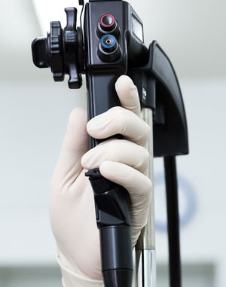
Endoscopy:
Less invasive, shorter procedure and for unstable patients
Visualization of mucosa
Main method of diagnosis in 61 of 67 cats with GIL
Endoscopic biopsy diagnosis in 56 of 61 (92%) cases
A study of 22 cats (12 with IBD and 10 with GIL) not passed in 8 of 22 cats.1/3 of duodenal biopsies obtained blindly
9 cats diagnosed with GIL via surgery and 1 via endoscopy

Slide 8
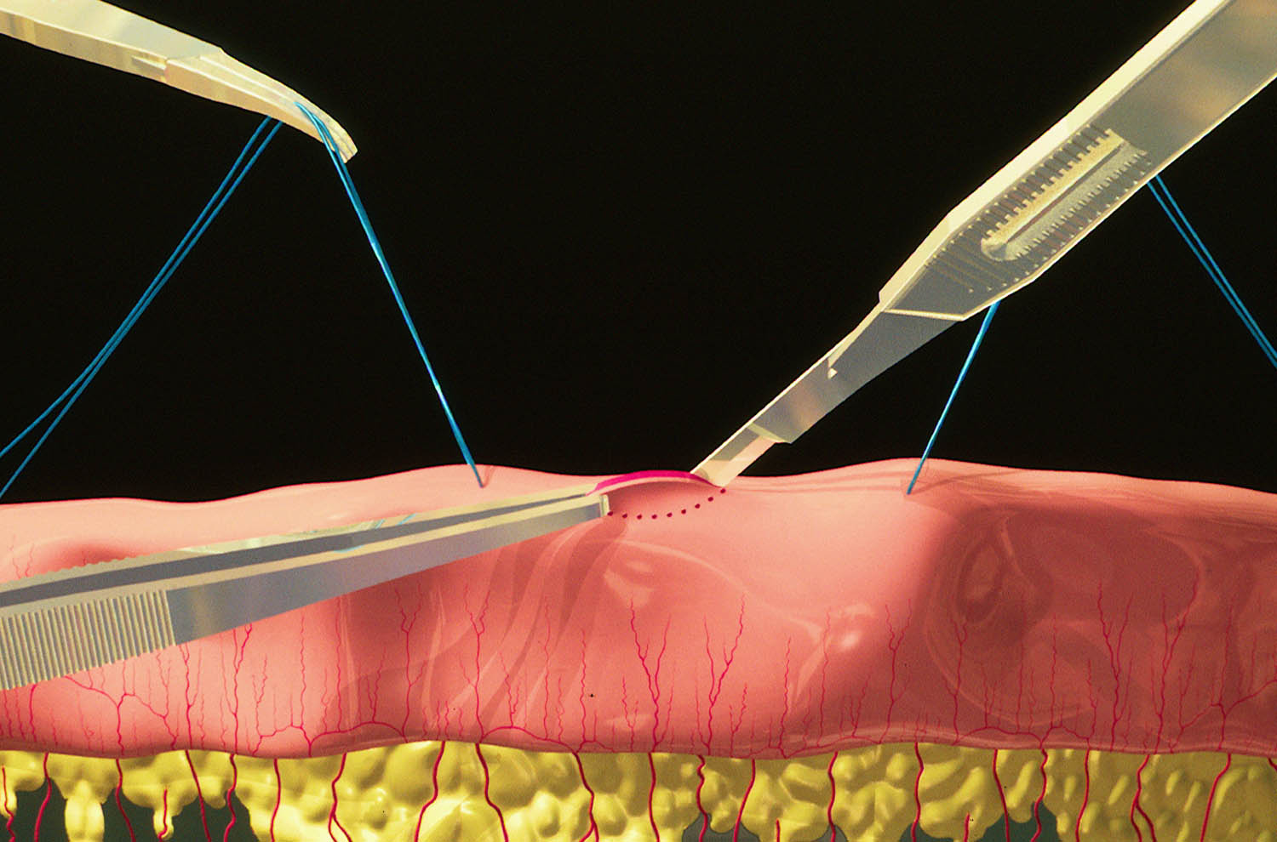
SURGICAL BIOPSIES:

Slide 9
STUDY AIM:
Can hypoalbuminaemia be used as a possible biomarker to aid in differentiation between GIL and IBD in cats?
HYPOTHESIS:
Hypoalbuminaemia lower in cats with GIL compared to IBD

Slide 10
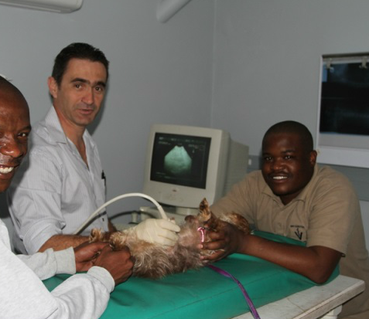
Materials and Methods-Study design
Medical records of 38 client owned cats diagnosed with GIL and IBD retrospectively evaluated
Multi-institutional study from practices in North America, Canada, and South Africa

Slide 11
Materials and Methods-Study design
Inclusion criteria:
Compatible history and clinical signs
Serum protein assay
Morphological evidence of intestinal thickening on US - performed by various ultrasonographers but images reviewed and evaluated by one specialist (E. Lindquist)
Endoscopically derived mucosal biopsies
Endoscopy performed at practices where ultrasound was done

Slide 12
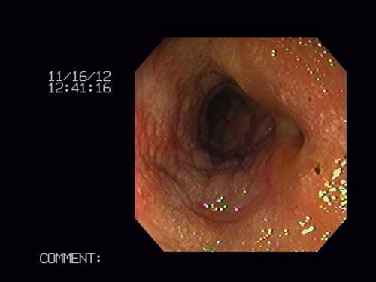
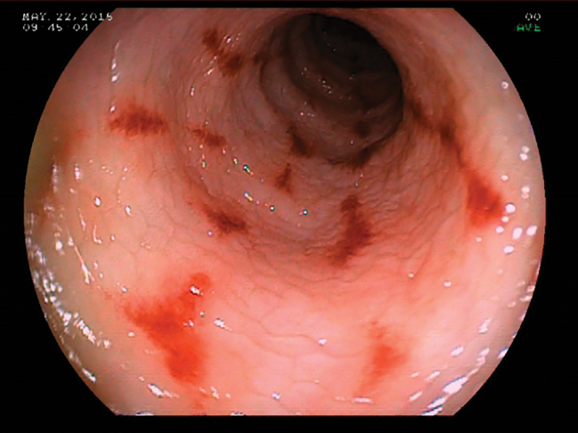
Materials and Methods: Groups
Based on endoscopic biopsies divided into 2 groups:
Group 1 → 25 cats with GIL
Group 2 →13 cats with IBD

Slide 13

Materials and Methods-Statistical analysis:
Degree of hypoalbuminaemia correlated between the 2 groups
Student T test
p <0.05

Slide 14
Results:
Group: | Age (years): | Median:
GIL | 3-19 | 10.1
IBD | 1-13 | 10.5
No statistical difference between the groups

Slide 16
Results:
Group: | Albumin (g/d)l: | Median:
GIL | 1.5-2.5 | 2
IBD | 2.5-3.5 | 2.75
Statistical difference between groups(p<0.05)

Slide 18
Results:

Slide 19
Discussion:
GIL and IBD common conditions causing GIT signs in cats
Chance of developing GIL higher with a previous diagnosis of IBD
Difficulty making diagnosis!!
Both require a histological diagnosis
Surgical biopsies>>>Endoscopic biopsies

Slide 20
Discussion:
This study:
Previous studies:
IBD age: Median 10.5, range 1-13 years
GIL age: Median 10.1,range 3-19 years
IBD albumin: Median 2.75 ,range 2.5-3.5g/dl
GIL albumin: Median of 2,range 1.5-2.5g/dl
IBD age: Median 10, range 1-17 years
GIL age: Median 13 ,range 4-18 years
IBD albumin: Median 3.15,range 1.6-4.1g/dl
GIL albumin: Median 3.0, range 2-4.1g/dl

Slide 21
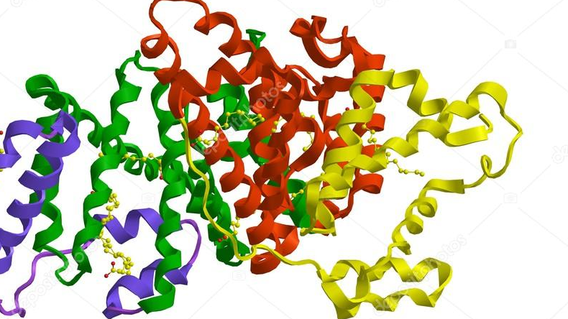
Conclusion:
Hypoalbuminaemia more common In GIL
Disruption of the intestinal wall integrity
Can still occur in both conditions
Cannot undervalue compatible history, ultrasound and biopsies!!!!!!
SERUM ALBUMIN CAN BE USED AS A BIOMARKER TO DIFFERENTIATE BETWEEN GIL AND IBD!!!

Slide 22

Limitations:
Purely retrospective study
No surgical biopsies taken

Slide 23
References:
Wolfesberger B, Fuchs-Baumgartinger A, Hammer SE, et al. World Health Organisation Classification of Lymphoid Tumours in Veterinary and Human Medicine: a Comparative Evaluation of Gastrointestinal Lymphomas in 61 Cats. J Comp Path 2018; 159: 1-10.
Allenspach K. Diagnosis of small intestinal disorders in dogs and cats. Vet Clin Small Anim 2013; 43: 1227-1240.
Jergens AE. Feline Idiopathic Inflammatory Bowel Disease: What we know and what remains to be unravelled. Journal of Feline Medicine and Surgery 2012; 14: 445-458.
Russell KJ, Beatty JA, Dhand N, et al. Feline low-grade alimentary lymphoma: how common is it? Journal of Feline Medicine and Surgery 2012; 14: 910-912.
Awaysheh A, Wilcke J, Elvinger F, et al. Evaluation of supervised machine learning algorithms to distinguish between inflammatory bowel disease and alimentary lymphoma in cats. Journal of Veterinary Diagnostic Investigation 2016; 28: 679-687.
Zwingenberger AL, Marks SL, Baker TW, et al. Ultrasonographic Evaluation of the Muscularis Propria in Cats with Diffuse Small Intestinal Lymphoma or Inflammatory Bowel Disease. J Vet Intern Med 2010; 24: 289-292.
Lingard AE, Briscoe K, Beatty JA, et al. Low-grade alimentary lymphoma: clinicopathological findings and response to treatment in 17 cases. Journal of Feline Medicine and Surgery 2009; 11: 692-700.
Evans SE, Bonczynski JJ, Broussard JD, et al. Comparison of endoscopic and full-thickness biopsy specimens for diagnosis of inflammatory bowel disease and alimentary tract lymphoma in cats. JAVMA 2006; 229: 1447-1450.

Slide 24

Thank you and any questions

